Slide 1
Factorising Algebraic expression: lesson 1
Week 2, Day 1

Slide 2

Mental set
See what you remember by simplifying the following.
1) 5a + 2a =
2) 3x + 2y - x + y =
3) 2(x+3) =
4) 3(2x + 3y) =
5) 10xy + 3yx -2yz =
Notes:
hook

Slide 3
Learning Intentions :
Students will be able to
Simplify algebraic expressions
Identify common factors in algebraic terms
Notes:
Lesson

Slide 4
24
7
30
Date
Title: Algebra techniques
EQ- How can we simplify algebraic term using factorising?
Algebra Review:
A term is a combination of a variable (a, b, x, y etc..) and a coefficient (number)
Like terms are expressions with the same variable
Like terms can be added and subtracted from each other
4ac and 3ca are like terms as they have the same variables, despite being in a different order
4ac + 3ca = 7ac- leave answers in alphabetical order.
5

Slide 5
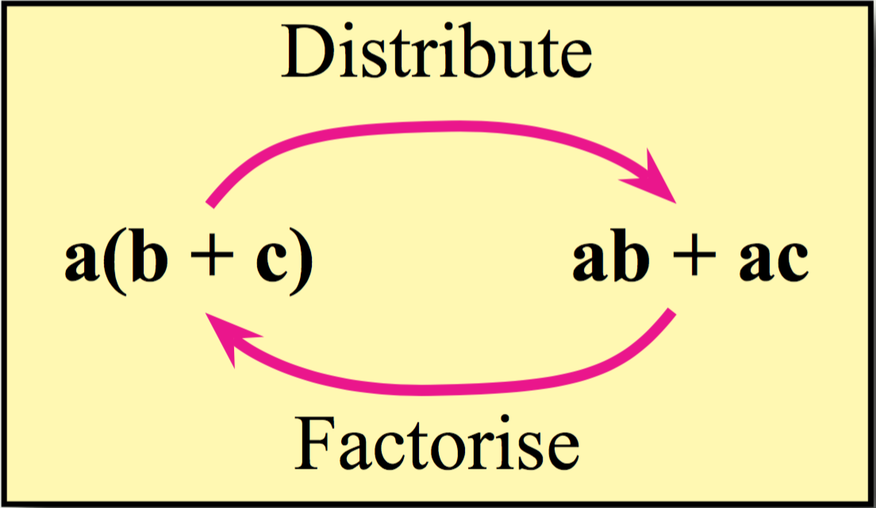
24
7
30
Date
Title: Algebra techniques
EQ- How can we simplify algebraic term using factorising?
Distributive law
When a coefficient is in front of a set of bracket, you distribute that value into the terms.
e.g.
5(2x + 3) becomes,
= (5 x 2x) + (5 x 3)
= 10x + 15
or with a variable
x(2x + y)
=(x x 2x) + (x x y)
=2x² + xy
So what is the opposite of distribution?
5
Notes:
Input

Slide 6
24
7
30
Title: Algebra techniques
Date
EQ- How can we simplify algebraic term using factorising?
Factorising
10ac and 5ab are not like terms, but have some common feature- “5” and “a”
To simplify this, we can remove “5” and “a” from both terms to get 5a(2c+b)
5a(2c + b) is the factorised form of 10ac and 5ab.
Factorising Process:
Look at all terms in an expression and identify all common factors- both numerical and variables.
Place these in front of a bracket
Write all terms without the removed factors – think dividing algebraic terms
5
Notes:
Lesson objective (EQ)

Slide 7
Guided Practice
Factorise the following:
12x + 36
12 is common, but x is not.
=12(x + 3)
To double check, distribute 12 back into the brackets
(12 x x) + (12 x 3)
12x + 36 ✓
2) 10xz - 25yz + 30bz
10 and 30 have a HCF of 10, but 10 does not go into 25 evenly, so it cant be 10.
5 goes into 25, 10 and 30, and is the HCF, so it goes at the front.
“z” is a common varaible in all three terms, so it also goes at the front.
=5z(2x – 5y + 6b)
To double check, distribute 5z back into the brackets
(5z x 2x) – (5z x5y) + (5z x 6b)
10xz – 25yz + 30bz ✓
Notes:
Guided practice

Slide 8
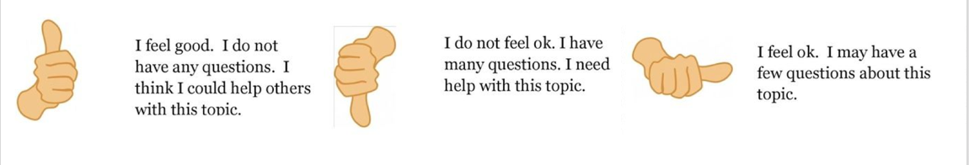
Check for understanding
Using your thumb, show the teacher you understanding of the learning
Notes:
Check for understanding

Slide 9
Success Criteria
You will know you are successful in achieving the objective if when you distribute the front value (coefficient) into the expression and come back to the original expression.

Slide 10
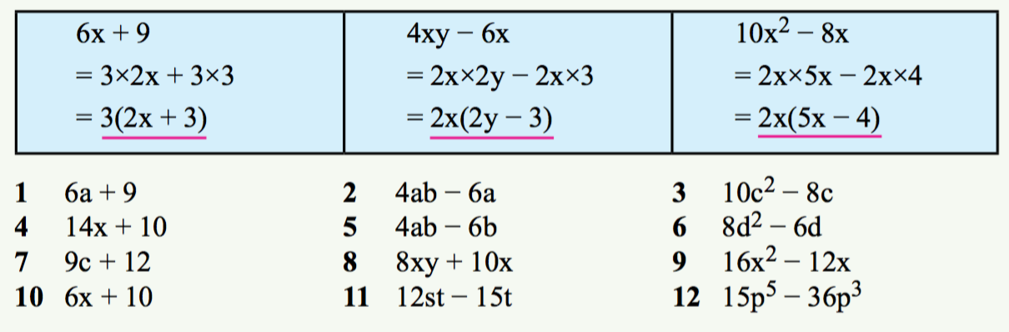
Activity: Dwyer 10, ex 1.4 - pg 5
Notes:
Independent practice

Slide 11
Closure activity
Write your summary Notes and Questions.
Were you able to complete the exercises successfully? When you checked them were you getting them correct?
Notes:
Closure

